Slide 1
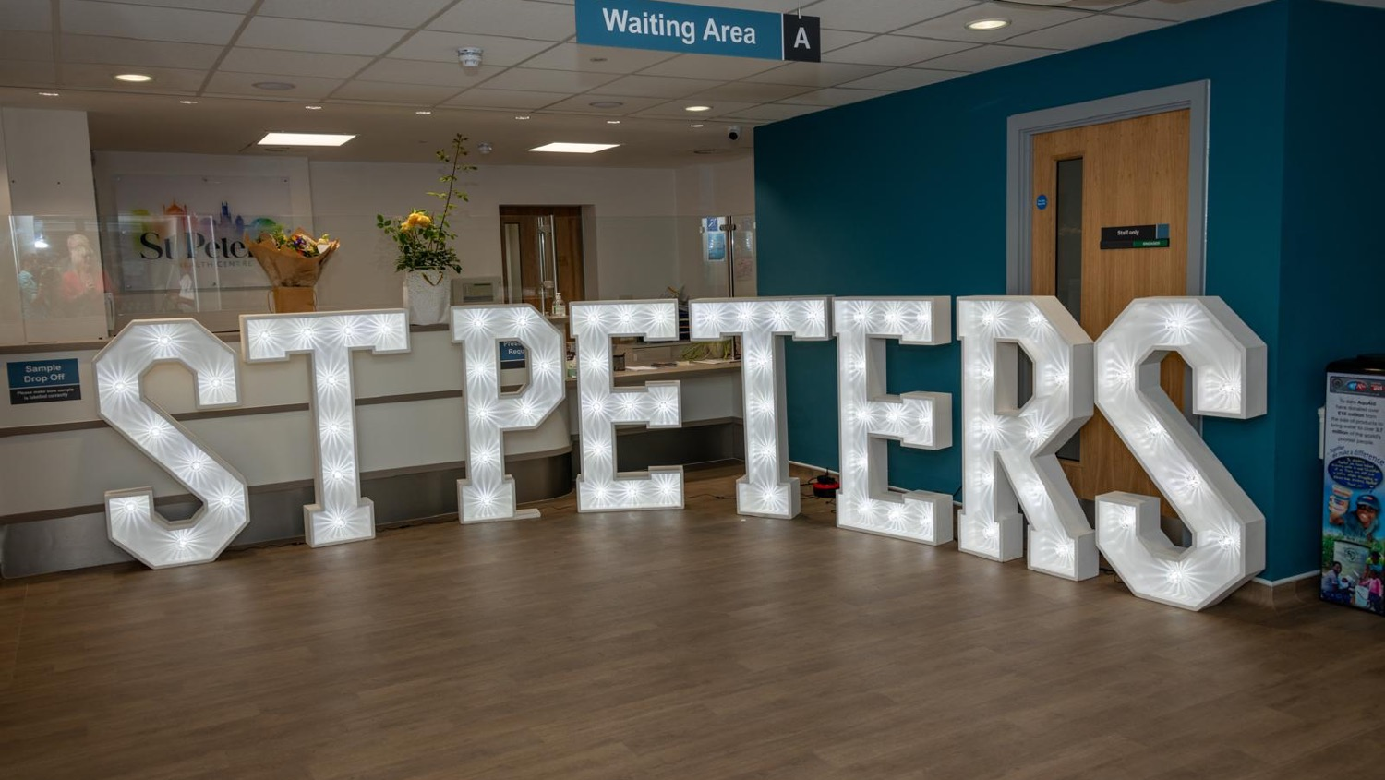
St Peter’s Patient Participation Group (PPG)

Slide 2
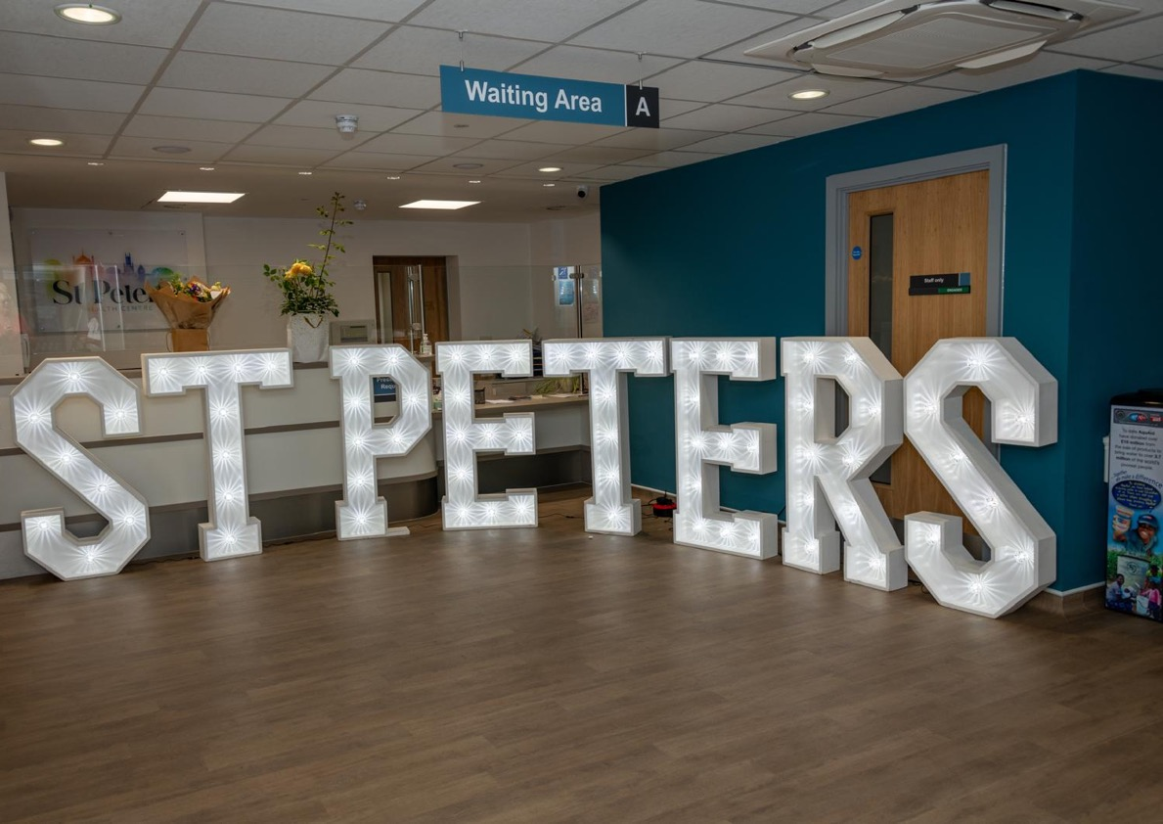
1. WELCOME to St Peter’s PPG!
PPG Committee – Who are we? What do we do?
Chairperson (chairs the PPG Meetings): Joanne Smith
Vice Chair (assists the chair and steps in when the chair is unavailable): Phillip Faithfull
Secretary (minutes meetings and supports the administrative work of the committee): role vacant
Committee Support Member (supports the wider work of the committee): Suzanne Hay
IT and Communications Lead (assist with the communication needs of the committee): Michael Collett

Slide 3
What is the PPG?
Members of the Patient Participation Group (PPG) are volunteers who support and influence healthcare at St Peter’s Health Centre by offering the patient’s perspective’ and acting as a ‘Critical Friend’. We work with the health centre to help find new ways of developing and improving services they provide.
The PPG will not deal with personal medical issues or complaints, as there are already well-established procedures that deal with these already in place.
The PPG group aims to meet three times a year to provide input and feedback into the development of services at the surgery and to discuss any related activities.
The Committee meets in-between to discuss with the leadership team at the practice, matters relating to the surgery, and for us to work together constructively to improve services

Slide 4
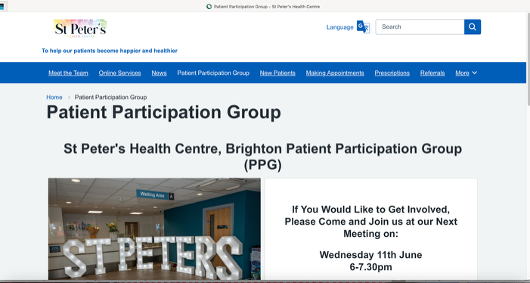
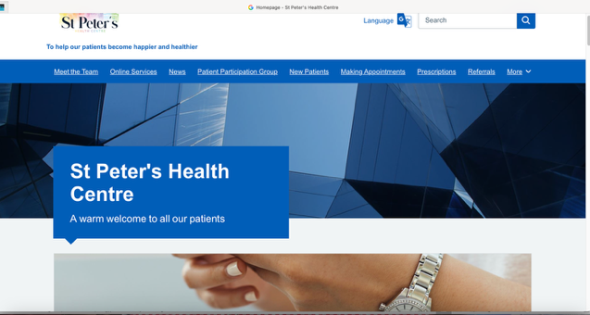
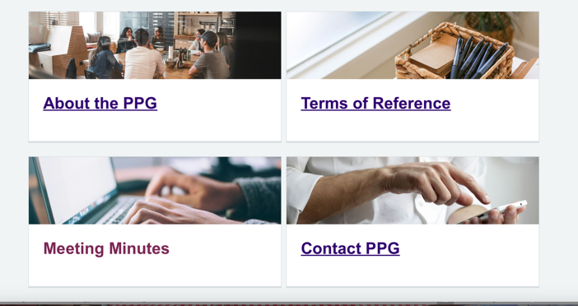
5. Information about St Peter’s PPG
https://www.stpetersmedicalcentre.co.uk/patient-participation-group
https://www.stpetersmedicalcentre.co.uk/

Slide 5
Matters Arising
  PPG grant application
  Pharmacy First session
  Healthy Hearts Event

Slide 6
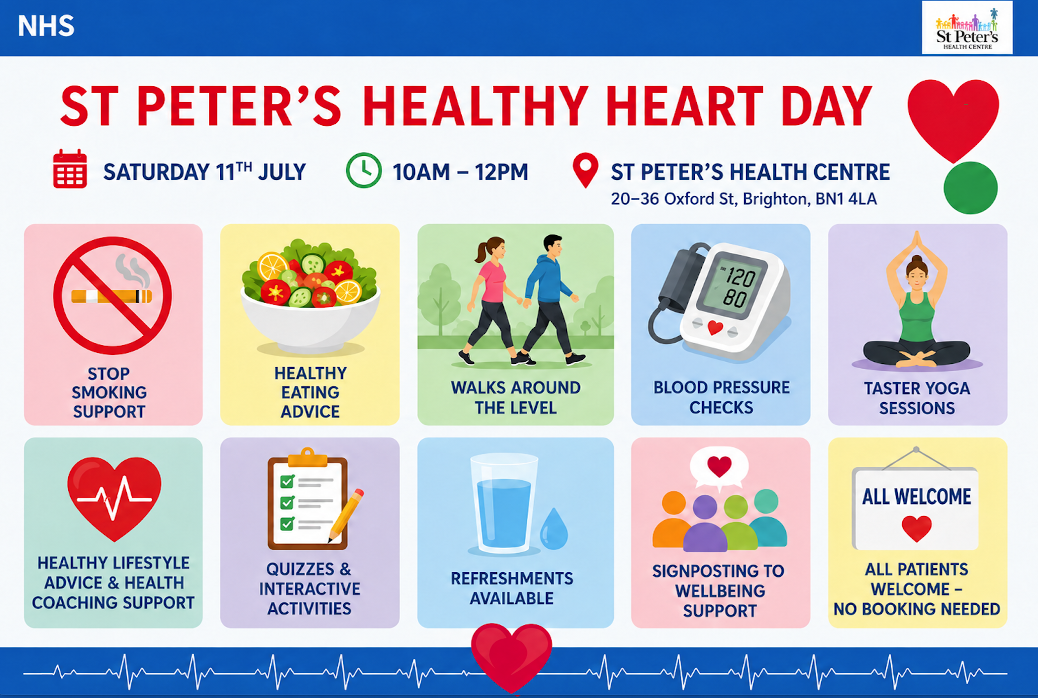

Slide 7
PPG Meeting Agenda
Tuesday 23rd June 2026
6-7.30pm
Welcome and introductions (Joanne)
  Purpose and scope of PPG
  Agree revised roles
  PPG active committee members /volunteers
Agree the minutes from 25th February meeting (Joanne)
Matters Arising/Actions (Joanne & St Peter’s staff)
  PPG grant application
  Pharmacy First session
  Healthy Hearts Event
St Peter’s update (Dr Jarvis)
  Self appointment link
  Use of Artificial Intelligence (AI)
5. PPG Updates (Joanne)
  Update from Sussex PPG Network – Robert?
  Menopause Café – Joanne
  Communication System
  Wider staff involvement/support
6. Discussion Focus:
  Future Health Education Events
  Widening Community Engagement
7. AOB (Joanne)
  Date of next Public Meeting – Oct tbc

Slide 8

St Peter’s Health Centre update (Dr Jarvis)

Slide 9
Staff updates
We have two new patient care advisors – Ed and Milly
Dr Jarvis will be away on sabbatical for 4 months from July
Dr Hannah Gould- Brown is now on maternity leave – she is being covered by Dr Guy Bidwell, who has previously worked at the practice as a locum

Slide 10
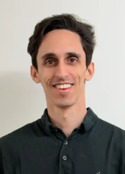
New GP starting soon!
Dr Yousif Sahib will be covering for Dr Jarvis while she is on sabbatical for 4 months from July
Dr Sahib graduated from the Royal College of Surgeons Ireland, MUB in 2016. He has worked in the Middle East and Ireland before coming to the UK in 2018 and doing several ENT jobs across England before moving to Brighton in 2022, when he swapped to GP training. Most recently he has been working in Mile Oak
Dr Sahib enjoys playing several instruments, playing badminton, and going to the gym when he's out of the office.

Slide 11
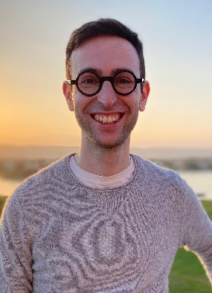
New GP starting soon !
Dr Sam Freeman will be starting at St Peter’s on 27th July
Dr Freeman qualified as a doctor from University College London in 2017. He has worked in Mile Oak and Allied Medical Practice locally . Dr Freeman has an interest in IT and AI and has worked with the hospital on their electronic patient record
In his spare time he is a school governor, enjoys singing , scuba diving and hiking

Slide 12
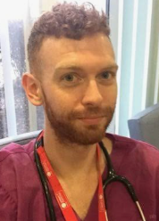
New GP starting soon!
Dr Jay Driscoll will be starting at St Peter’s in September
Dr Driscoll qualified as a GP from Warwick Medical School in 2013. He has worked as a lead GP at Sussex Primary Care , most recently in Newhaven. His clinical interests include lifestyle management in long term conditions, mens’ health and palliative care

Slide 13
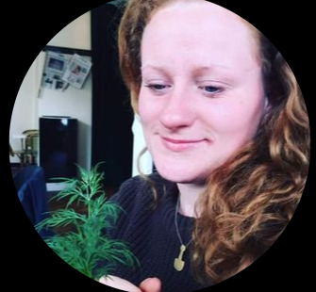
New Advanced Nurse Practitioner and New Health Care Assistant
Jo Riseley has recently moved from London to start work at St Peter’s. She will be working with Pippa, our existing ANP, to improve care of patients with long term conditions
Shirley Kempshall has recently started as a Healthcare Assistant at St Peter’s. Beth and Maddie have moved back into our Patient Care Advisor team

Slide 14
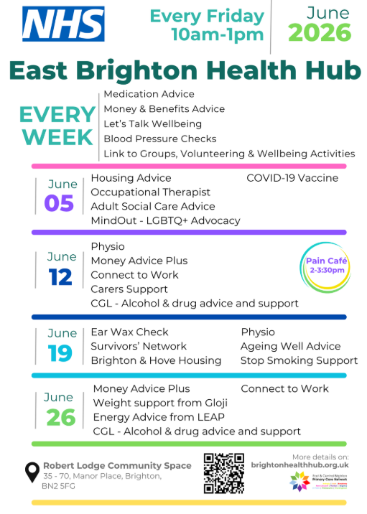
Every Friday at Robert Lodge
35-70, Robert Lodge Community Space, Manor Place, Brighton, BN2 5FG
Our East Brighton Health Hub is a drop-in service based in Robert Lodge every Friday (10am-1pm) – There is always support with mental health, social prescribing and a clinical pharmacist
The Hub was a awarded a regional champion award for health innovation
Once a month there is a clinic run by a Consultant Respiratory Doctor and a Specialist Respiratory Nurse
Once a month we hold a Pain Café
Our social prescriber Joe Walker is also at St Peters on Tuesday afternoons – appointments can be booked at reception to help with isolation, money or housing issues

Slide 15
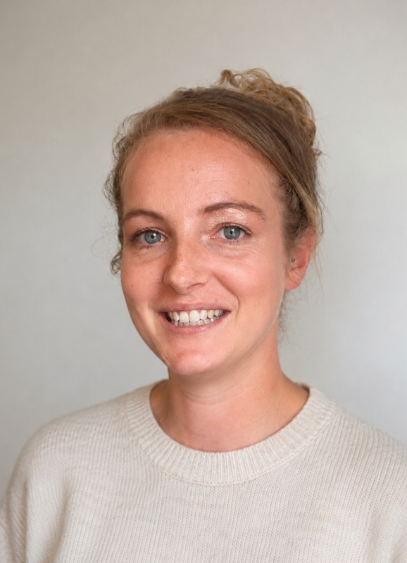
Proactive care/ Avoidable admissions
Jerry Whitmore is the lead PCN nurse working with Sarah Keen and Hannah Green to support our housebound patients and people with increasing frailty
The team can do reviews of chronic diseases at home and produce individual care plans for them – including RESPECT forms
We can identify people at greatest risk of admission from avoidable causes – eg falls, flu, covid and do individual work with them

Slide 16
Clinical priorities
We are working with the PCN team to improve care of people aged 18-40 with Diabetes. Kathy and Grace have been telephoning people and asking them what the barriers to care are and we are working with a health coach to support them
We are continuing to offer liver fibroscans at the practice to screen patients at high risk of liver disease – including people who drink higher levels of alcohol or people who are overweight and diabetic
We have a new FENO machine to improve care of people with COPD and Asthma and are working closely with the hospital Respiratory team
Our care of people with high blood pressure is improving – 72% now have good control – up 5% on last year

Slide 17
  Self appointment link and use of Artificial Intelligence (AI)
  We are exploring ways to improve triage and make sure that everyone gets the right advice first time
  Currently all requests are reviewed by a GP, and this can lead to delays in advice
  We are constantly tweaking the system to improve systems for patients
  Patients are now asked if they are happy to have a self booking link texted so that they can arrange an appointment when convenient for them
  Some clinicians are using AI programmes to help write notes - these do not share information outside

Slide 18
National Issues
Why is this happening?
NHS England is reviewing GP patient lists to remove people who may have moved away and no longer use their registered practice.
These patients are sometimes called "ghost patients."
Around 344,000 registrations have been removed nationally in the last 6 months.
What might happen?
Some patients receive a letter from Primary Care Support England (PCSE) asking them to confirm their address.
If no response is received within 30 days, patients may be removed from their GP practice list.
Why is this a concern?
People may not respond because:
  They think the letter is a scam.
  They are away, busy, or do not receive the letter.
  They have dementia, learning disabilities, language barriers, or unstable housing.
Some patients may discover they are no longer registered only when they try to book an appointment.
What should patients do?
✓ Keep your address and contact details up to date with the practice.
✓ Open and respond to any letters from PCSE about your registration.
✓ Contact the practice if you are unsure whether a letter is genuine.
Impact on GP Practices
Practices must check large numbers of proposed removals to protect vulnerable patients.
This creates significant additional administrative work for practice teams.
Key Message:
If you receive a letter asking you to confirm your registration details, please respond promptly to avoid being removed from the practice list.

Slide 19
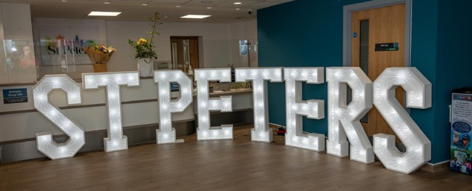
5. PPG Updates (Joanne)
  Update from Sussex PPG Network – Robert?
  PPG Network – social media session – Michael?
  Menopause Café – Joanne
  Communication System
  Wider staff involvement/support
6. Discussion Focus:
  Future Health Education Events
  Widening Community Engagement

Slide 20
7. AOB
Next PPG meeting: October (date tbc)

